Slide 1
Efficient Algorithms
Ekkapot Charoenwanit
Software Systems Engineering
TGGS
KMUTNB

Slide 2
Lecture 9: Graph Algorithms (Part I)

Slide 3
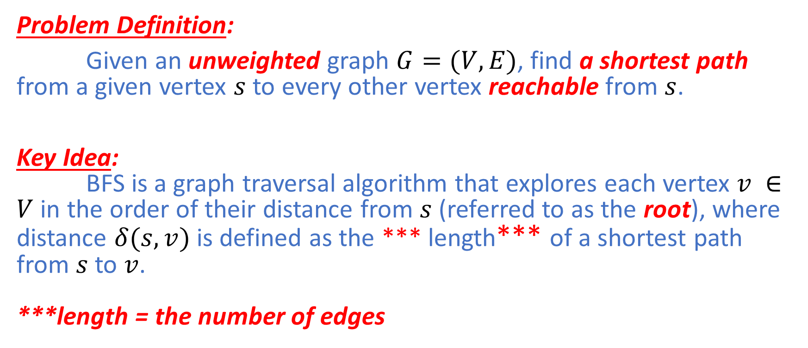
Breadth-First Search (BFS)
Problem Definition:
Given an unweighted graph $G=(V,E)$, find a shortest path from a given vertex $s$ to every other vertex reachable from $s$.
Key Idea: BFS is a graph traversal algorithm that explores each vertex $v ∈V$ in the order of their distance from $s$ (referred to as the root), where distance $δ(s,v)$ is defined as the *** length*** of a shortest path from $s$ to $v$. ***length = the number of edges

Slide 4
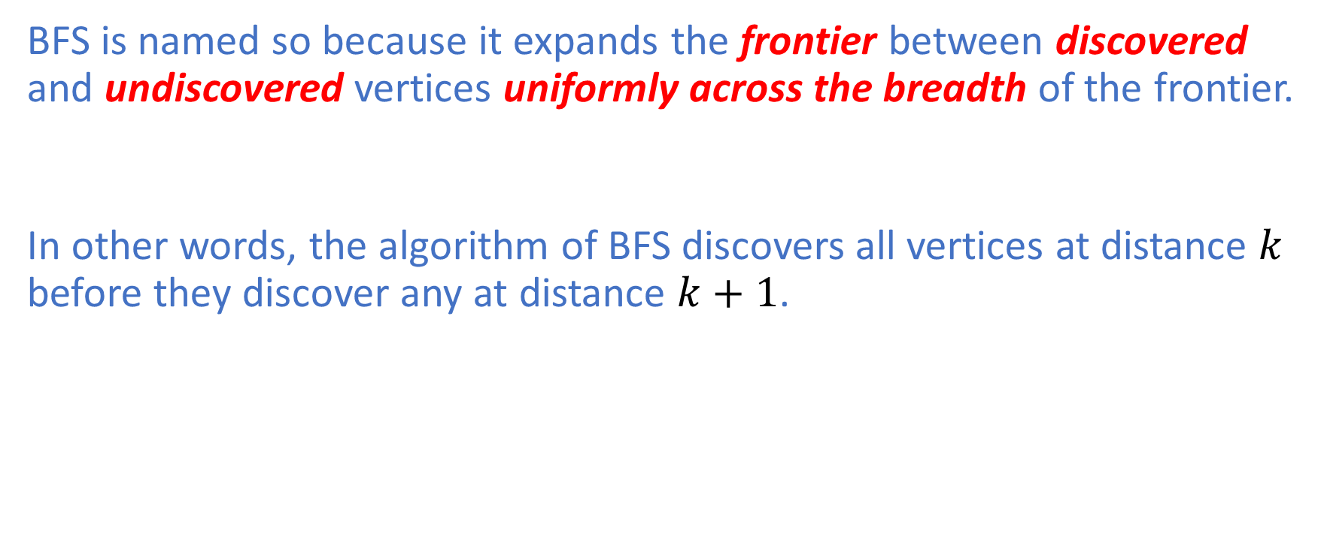
Breadth-First Search (BFS)
BFS is named so because it expands the frontier between discovered and undiscovered vertices uniformly across the breadth of the frontier.
In other words, the algorithm of BFS discovers all vertices at distance $k$ before they discover any at distance $k+1$.

Slide 5
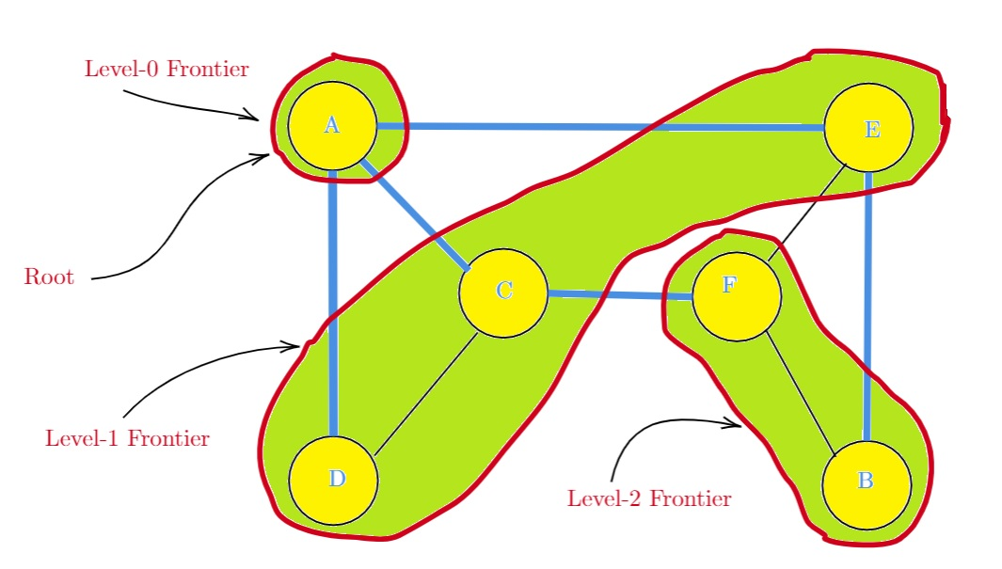

Breadth-First Search (BFS): Example
BFS traverses the graph, starting from $A$.
$A$ itself forms the level-0 frontier.
$C$, $D$ and $E$ form the level-1 frontier.
$B$ and $F$ form the level-2 frontier.

Slide 6
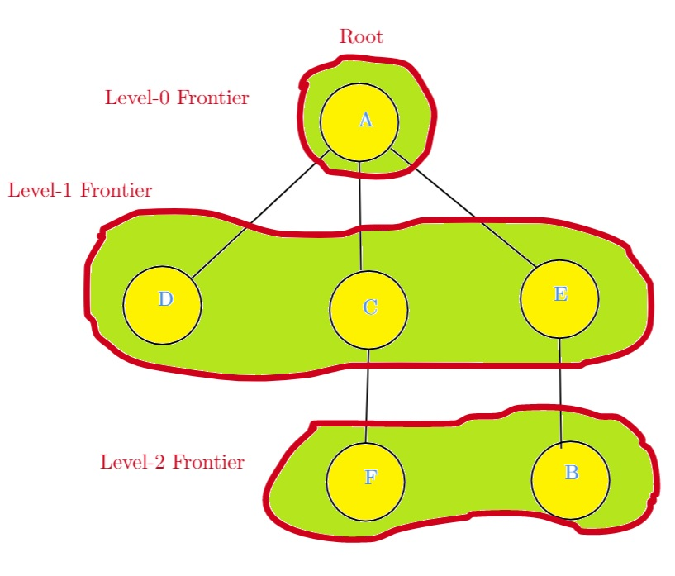
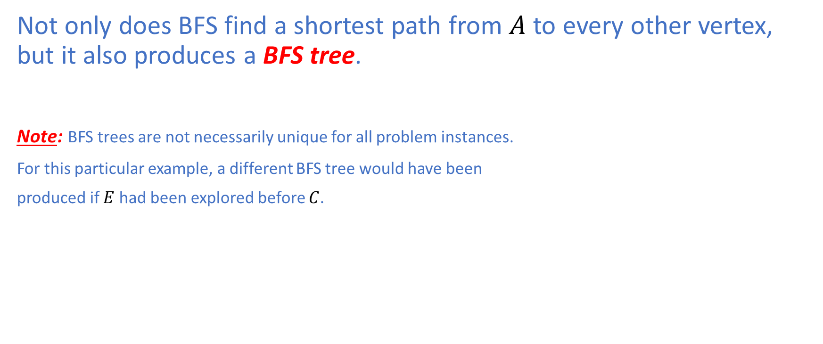
Breadth-First Search (BFS): Example
Not only does BFS find a shortest path from $A$ to every other vertex, but it also produces a BFS tree.
Note: BFS trees are not necessarily unique for all problem instances.
For this particular example, a different BFS tree would have been
produced if $E$ had been explored before $C$.

Slide 7
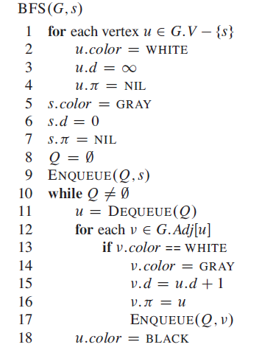
Breadth-First Search (BFS): Color
BFS colors each vertex to keep track of its progress.
White = undiscovered
Gray = discovered and still in the frontier
Black = discovered but not in the frontier any more
All vertices start out white (Line 2), except for the root, which
starts out gray (Line 5).

Slide 8
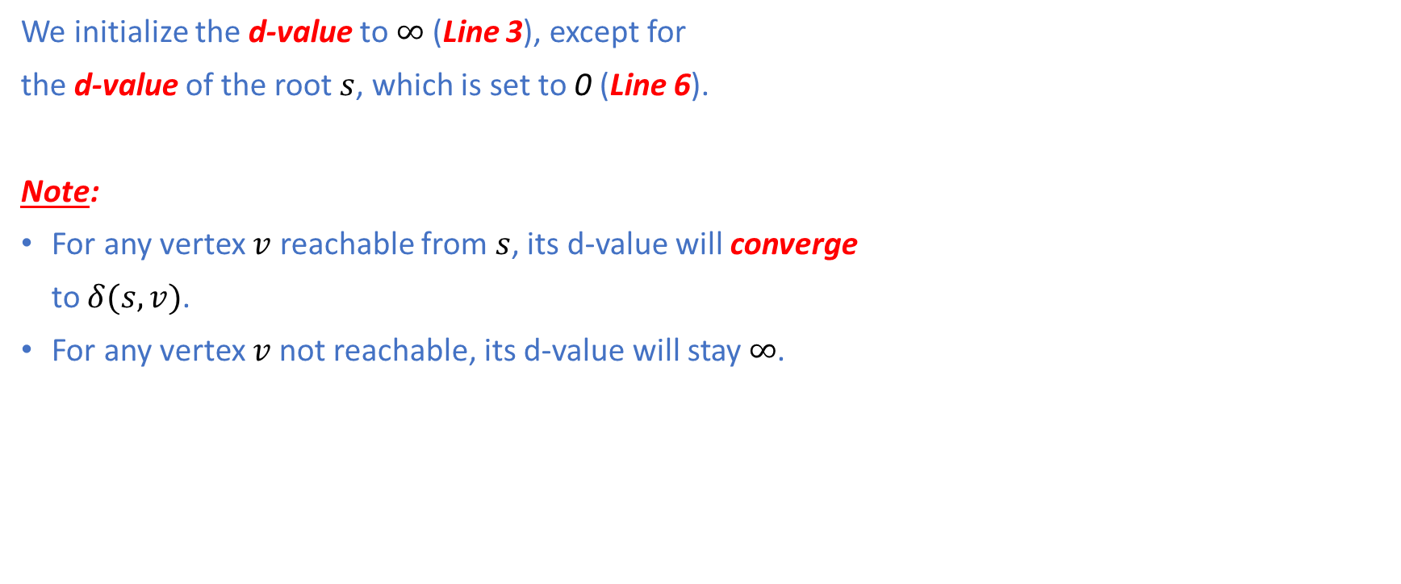
Breadth-First Search (BFS): Distance
We initialize the d-value to $∞$ (Line 3), except for
the d-value of the root $s$, which is set to 0 (Line 6).
Note:
For any vertex $v$ reachable from $s$, its d-value will converge
to $δ(s,v)$.
For any vertex $v$not reachable, its d-value will stay $∞$.

Slide 9
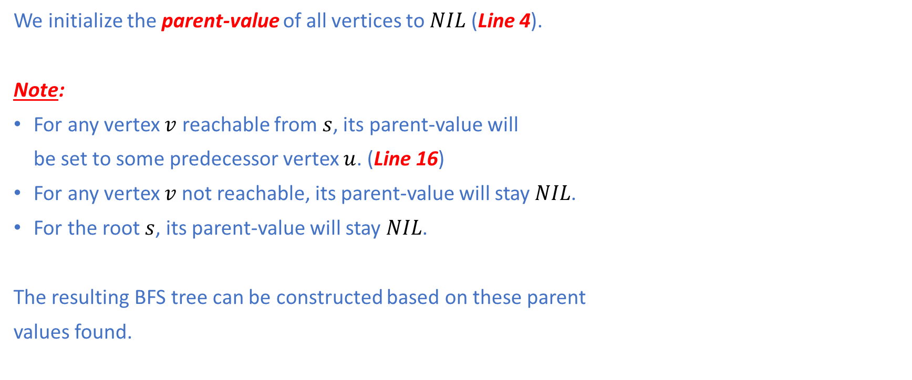
Breadth-First Search (BFS): Parent
We initialize the parent-value of all vertices to $NIL$ (Line 4).
Note:
For any vertex $v$ reachable from $s$, its parent-value will
be set to some predecessor vertex $u$. (Line 16)
For any vertex $v$not reachable, its parent-value will stay$NIL$.
For the root $s$, its parent-value will stay $NIL$.
The resulting BFS tree can be constructed based on these parent
values found.

Slide 10
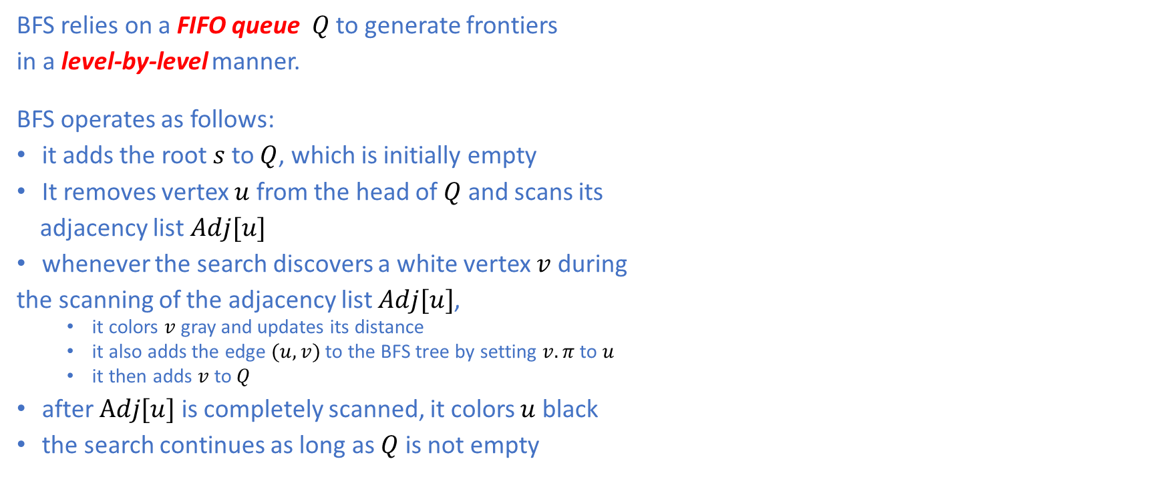
Breadth-First Search (BFS)
BFS relies on a FIFO queue $Q$ to generate frontiers
in a level-by-level manner.
BFS operates as follows:
it adds the root $s$ to $Q$, which is initially empty
It removes vertex $u$ from the head of $Q$ and scans its
adjacency list $Adj[u]$
whenever the search discovers a white vertex $v$ during
the scanning of the adjacency list $Adj[u]$,
it colors $v$gray and updates its distance
it also adds the edge $(u,v)$ to the BFS tree by setting $v.π$ to $u$
it then adds $v$ to $Q$
after $Adj[u]$ is completely scanned, it colors $u$ black
the search continues as long as $Q$ is not empty

Slide 11
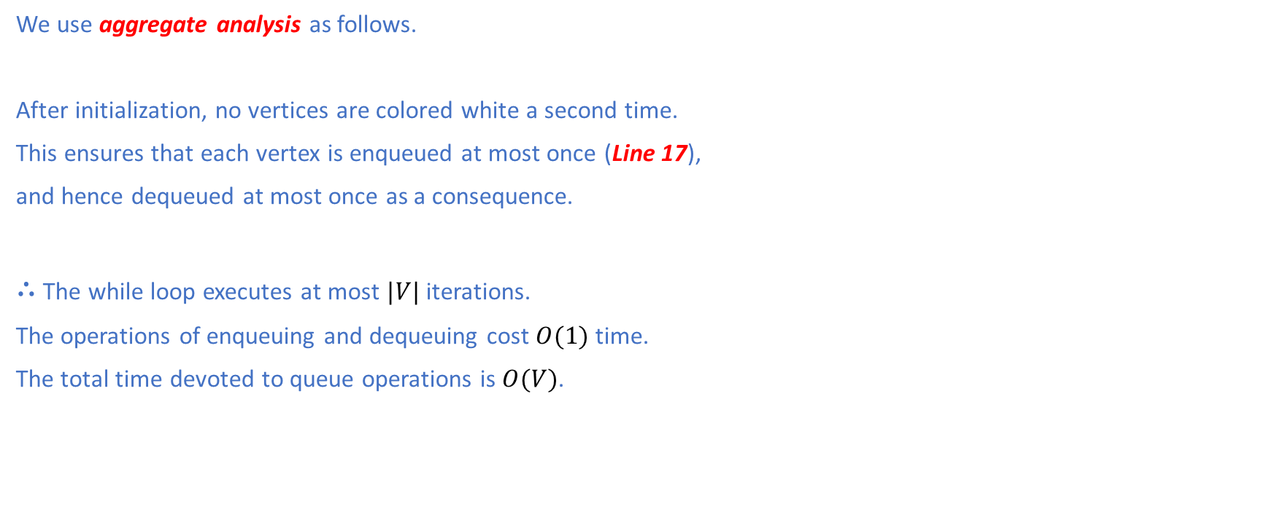
Breadth-First Search (BFS): Analysis
We use aggregate analysis as follows.
After initialization, no vertices are colored white a second time.
This ensures that each vertex is enqueued at most once (Line 17),
and hence dequeued at most once as a consequence.
$∴$ The while loop executes at most $|V|$ iterations.
The operations of enqueuing and dequeuing cost $O(1)$ time.
The total time devoted to queue operations is $O(V)$.

Slide 12

Breadth-First Search (BFS): Analysis
BFS scans the adjacency list of each dequeued vertex at most once
Therefore, the total time spent on examining adjacent vertices is $O(E)$.
The total running time is $O(V+E)$.
Note: For undirected graphs, the number of edges is $2E$.
For directed graphs, the number of edges is $E$.

Slide 13
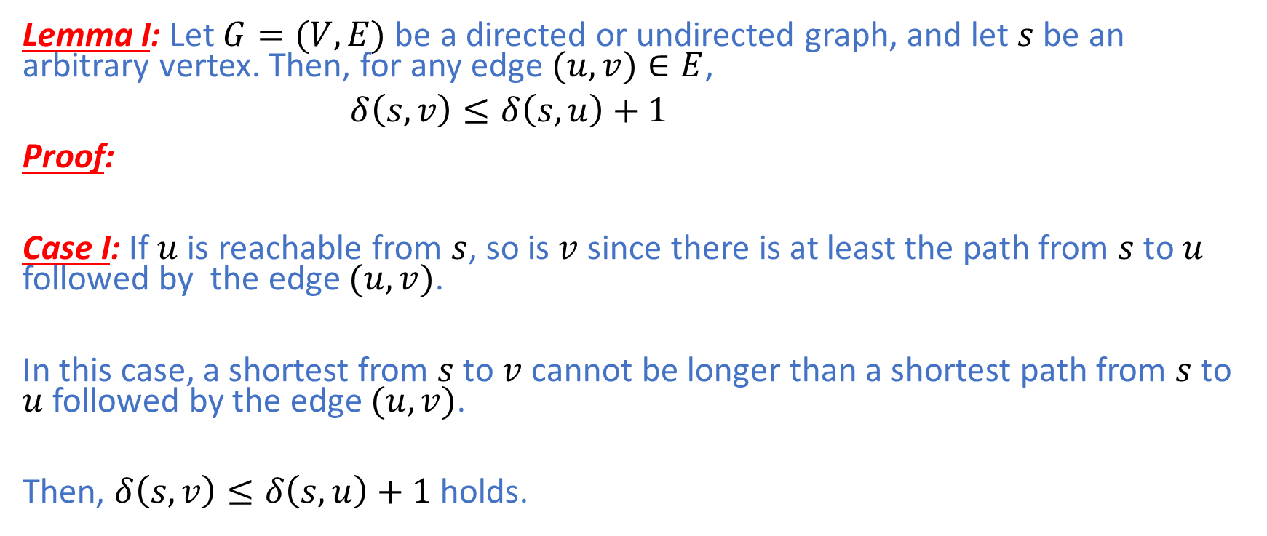
Breadth-First Search (BFS): Correctness
Lemma I: Let $G=(V,E)$ be a directed or undirected graph, and let $s$ be an arbitrary vertex. Then, for any edge $(u,v)∈E$,
$δ\left(s,v\right)≤δ\left(s,u\right)+1$
Proof:
Case I: If $u$ is reachable from $s$, so is $v$ since there is at least the path from $s$ to $u$ followed by the edge $(u,v)$.
In this case, a shortest from $s$ to $v$ cannot be longer than a shortest path from $s$ to $u$ followed by the edge $(u,v)$.
Then, $δ\left(s,v\right)≤δ\left(s,u\right)+1$ holds.

Slide 14
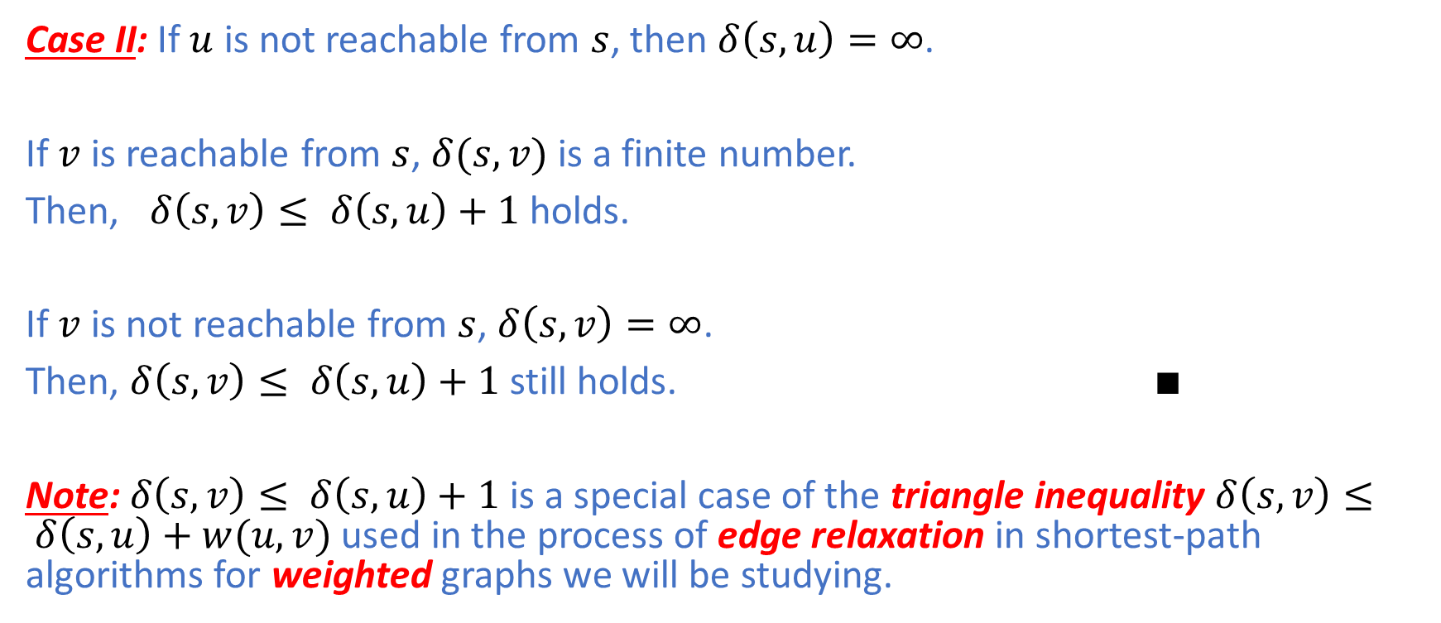
Breadth-First Search (BFS): Correctness
Case II: If $u$ is not reachable from $s$, then $δ\left(s,u\right)=∞$.
If $v$ is reachable from $s$, $δ(s,v)$ is a finite number.
Then, $δ\left(s,v\right)≤ δ\left(s,u\right)+1$ holds.
If $v$ is not reachable from $s$, $δ\left(s,v\right)=∞$.
Then, $δ\left(s,v\right)≤ δ\left(s,u\right)+1$ still holds. $∎$
Note: $δ\left(s,v\right)≤ δ\left(s,u\right)+1$ is a special case of the triangle inequality $δ\left(s,v\right)≤ δ\left(s,u\right)+w(u,v)$ used in the process of edge relaxation in shortest-path algorithms for weighted graphs we will be studying.

Slide 15
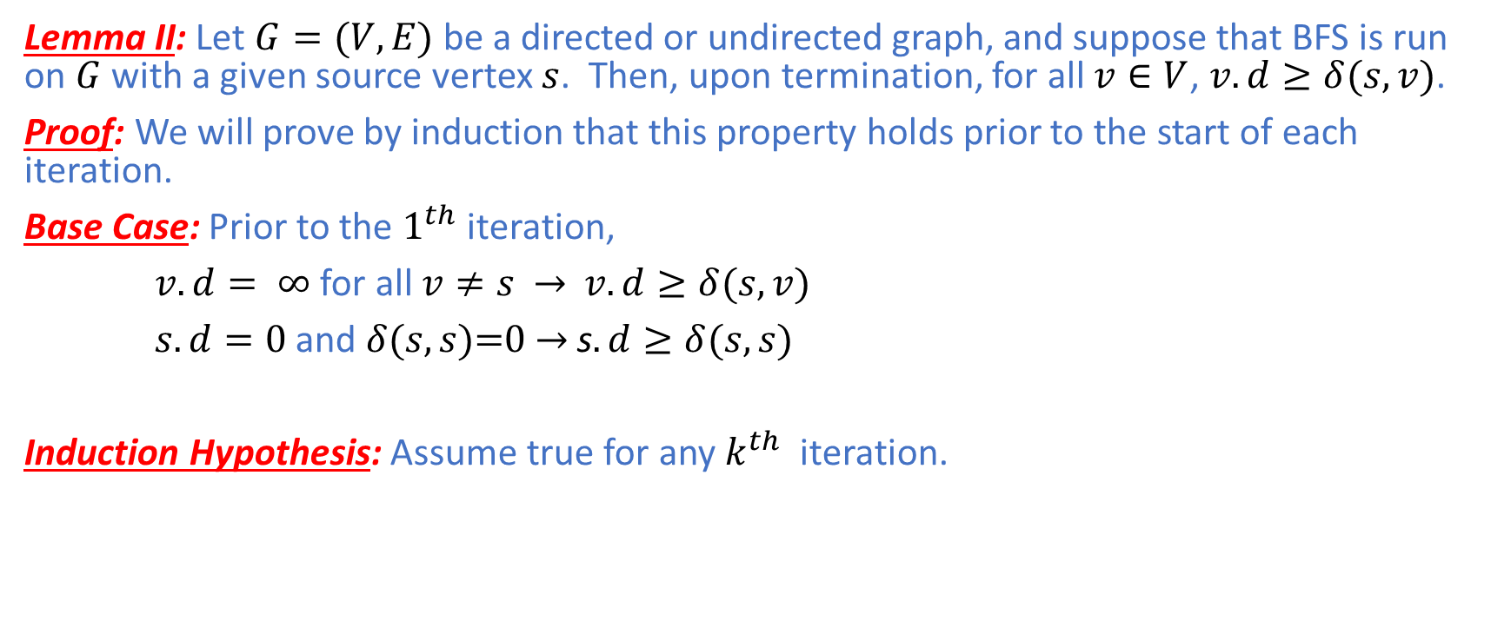
Breadth-First Search (BFS): Correctness
Lemma II: Let $G=(V,E)$ be a directed or undirected graph, and suppose that BFS is run on $G$ with a given source vertex $s$. Then, upon termination, for all $v∈V$, $v.d≥δ(s,v)$.
Proof: We will prove by induction that this property holds prior to the start of each iteration.
Base Case: Prior to the $1^{th}$ iteration,
$v.d= ∞$ for all $v≠s$ $→$ $v.d≥δ(s,v)$
$s.d=0$ and $δ(s,s)\text{=0}$ $→$ s$.d≥δ(s,s)$
Induction Hypothesis: Assume true for any $k^{th}$ iteration.

Slide 16
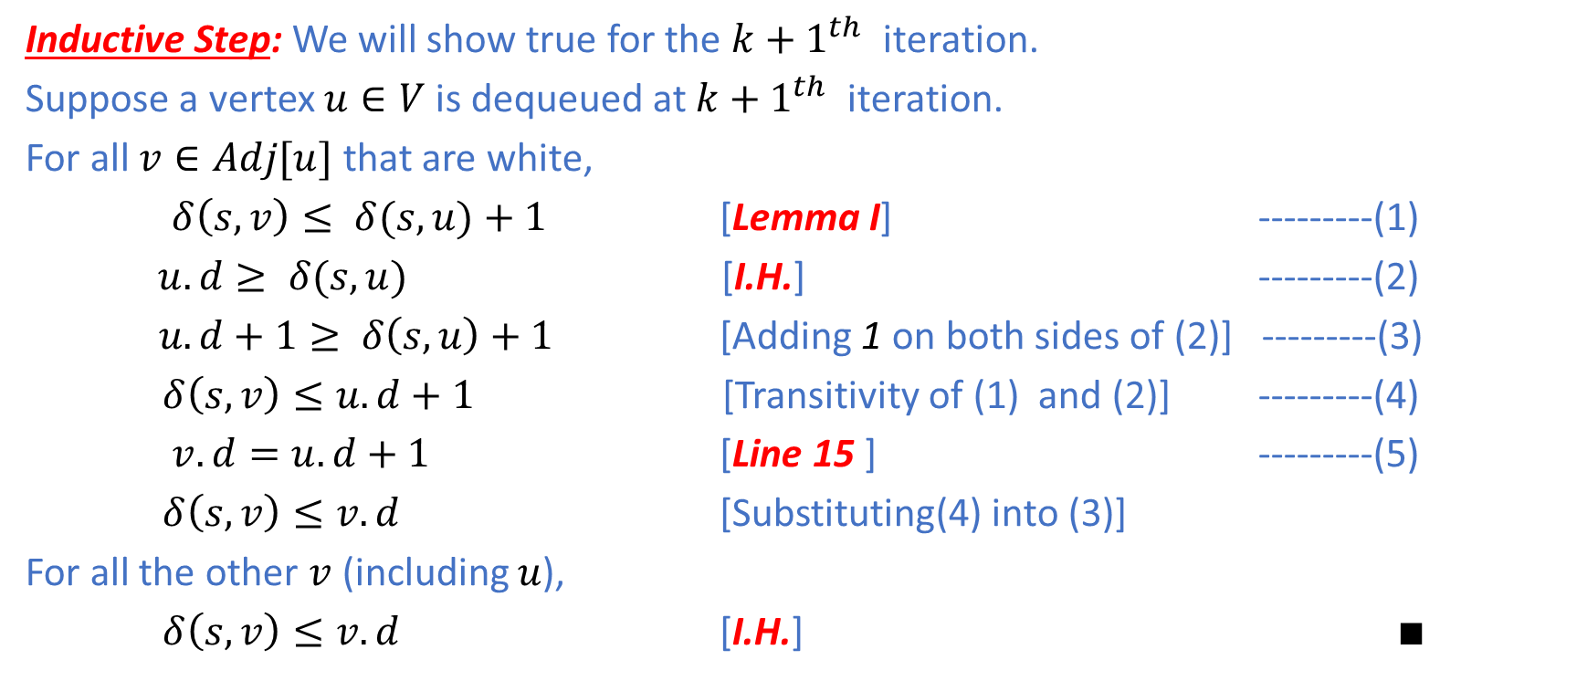
Breadth-First Search (BFS): Correctness
Inductive Step: We will show true for the ${k+1}^{th}$ iteration.
Suppose a vertex $u∈V$ is dequeued at ${k+1}^{th}$ iteration.
For all $v∈Adj[u]$ that are white,
$δ\left(s,v\right)≤ δ(s,u)+1$ [Lemma I] ---------(1)
$u.d≥ δ(s,u)$ [I.H.] ---------(2)
$u.d+1≥ δ\left(s,u\right)+1$ [Adding 1 on both sides of (2)] ---------(3)
$δ\left(s,v\right)≤u.d+1$ [Transitivity of (1) and (2)] ---------(4)
$v.d=u.d+1$ [Line 15 ] ---------(5)
$δ\left(s,v\right)≤v.d$ [Substituting(4) into (3)]
For all the other $v$(including $u$),
$δ\left(s,v\right)≤v.d$ [I.H.] $∎$

Slide 17
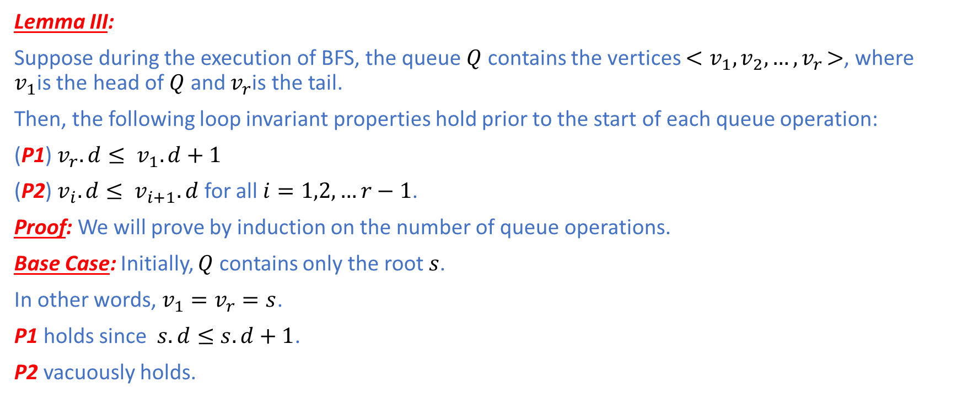
Breadth-First Search (BFS): Correctness
Lemma III:
Suppose during the execution of BFS, the queue $Q$ contains the vertices $<v_{1},v_{2},…{,v}_{r}>$, where $v_{1}$is the head of $Q$ and $v_{r}$is the tail.
Then, the following loop invariant properties hold prior to the start of each queue operation:
(P1) $v_{r}.d≤ v_{1}.d+1$
(P2) $v_{i}.d≤ v_{i+1}.d$ for all $i=1,2,…r−1$.
Proof: We will prove by induction on the number of queue operations.
Base Case: Initially, $Q$ contains only the root $s$.
In other words, ${v_{1}=v}_{r}=s$.
P1 holds since $s.d≤s.d+1$.
P2 vacuously holds.

Slide 18
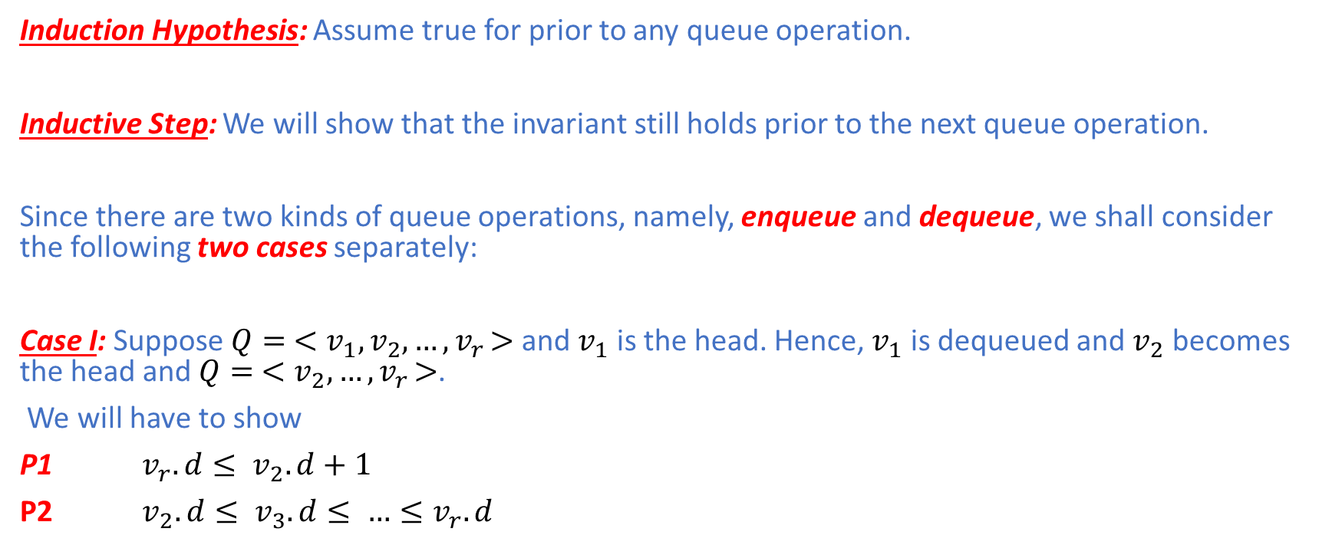
Breadth-First Search (BFS): Correctness
Induction Hypothesis: Assume true for prior to any queue operation.
Inductive Step: We will show that the invariant still holds prior to the next queue operation.
Since there are two kinds of queue operations, namely, enqueue and dequeue, we shall consider the following two cases separately:
Case I: Suppose $Q= <v_{1},v_{2},…{,v}_{r}>$ and $v_{1}$ is the head. Hence, $v_{1}$ is dequeued and $v_{2}$ becomes the head and $Q= <v_{2},…{,v}_{r}>$.
We will have to show
P1 $v_{r}.d≤ v_{2}.d+1$
P2 $v_{2}.d≤ v_{3}.d≤ …≤v_{r}.d$

Slide 19
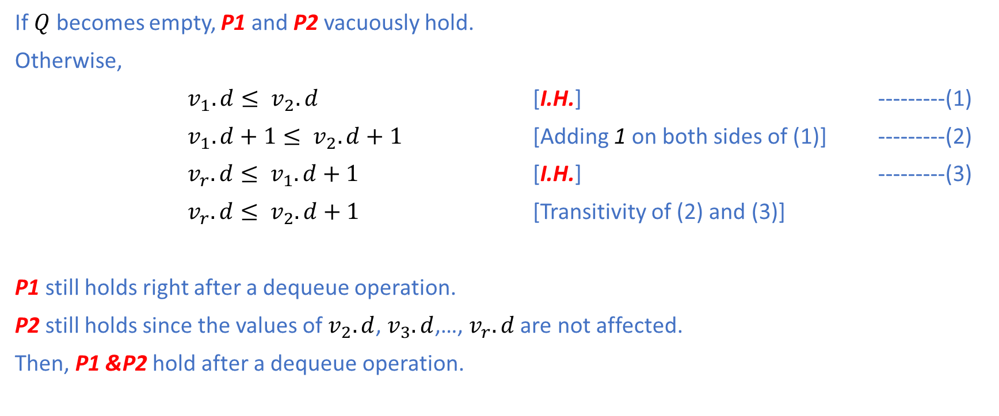
Breadth-First Search (BFS): Correctness
If $Q$ becomes empty, P1 and P2 vacuously hold.
Otherwise,
$v_{1}.d≤ v_{2}.d$ [I.H.] ---------(1)
$v_{1}.d+1≤ v_{2}.d+1$ [Adding 1 on both sides of (1)] ---------(2)
$v_{r}.d≤ v_{1}.d+1$ [I.H.] ---------(3)
$v_{r}.d≤ v_{2}.d+1$ [Transitivity of (2) and (3)]
P1 still holds right after a dequeue operation.
P2 still holds since the values of $v_{2}.d$, $v_{3}.d$,…, $v_{r}.d$ are not affected.
Then, P1 &P2 hold after a dequeue operation.

Slide 20
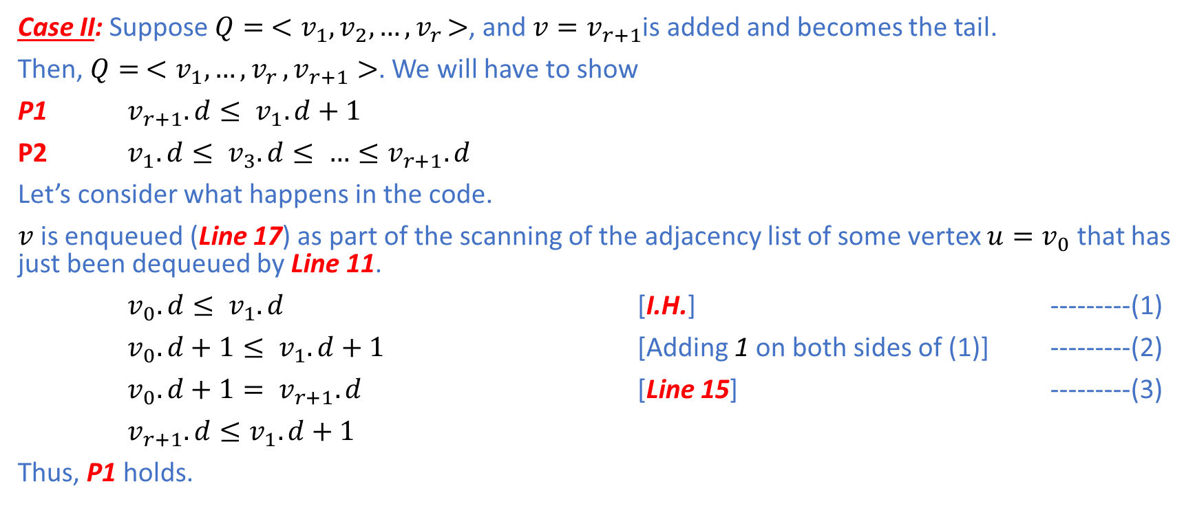
Breadth-First Search (BFS): Correctness
Case II: Suppose $Q= <v_{1},v_{2},…{,v}_{r}>$, and ${v=v}_{r+1}$is added and becomes the tail.
Then, $Q= <v_{1},…{,v}_{r},v_{r+1}>$. We will have to show
P1 $v_{r+1}.d≤ v_{1}.d+1$
P2 $v_{1}.d≤ v_{3}.d≤ …≤v_{r+1}.d$
Let’s consider what happens in the code.
$v$is enqueued (Line 17) as part of the scanning of the adjacency list of some vertex ${u=v}_{0}$ that has just been dequeued by Line 11.
$v_{0}.d≤ v_{1}.d$ [I.H.] ---------(1)
$v_{0}.d+1≤ v_{1}.d+1$ [Adding 1 on both sides of (1)] ---------(2)
$v_{0}.d+1= v_{r+1}.d$ [Line 15] ---------(3)
$v_{r+1}.d≤v_{1}.d+1$
Thus, P1 holds.

Slide 21
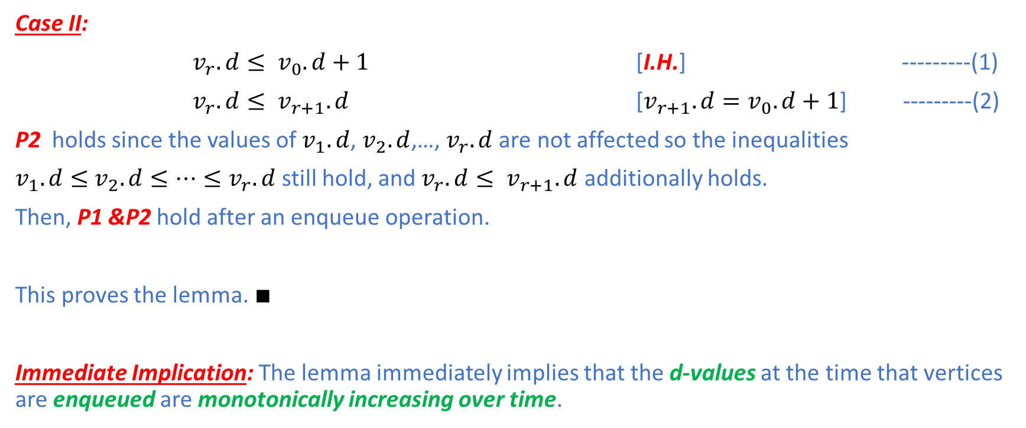
Breadth-First Search (BFS): Correctness
Case II:
$v_{r}.d≤ v_{0}.d+1$ [I.H.] ---------(1)
$v_{r}.d≤ v_{r+1}.d$ [$v_{r+1}.d=v_{0}.d+1$] ---------(2)
P2 holds since the values of $v_{1}.d$, $v_{2}.d$,…, $v_{r}.d$ are not affected so the inequalities
$v_{1}.d≤$ $v_{2}.d≤…≤v_{r}.d$ still hold, and $v_{r}.d≤ v_{r+1}.d$ additionally holds.
Then, P1 &P2 hold after an enqueue operation.
This proves the lemma. $∎$
Immediate Implication: The lemma immediately implies that the d-values at the time that vertices are enqueued are monotonically increasing over time.

Slide 22
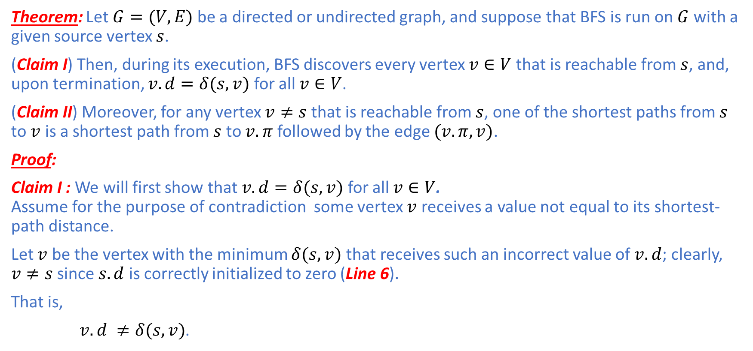
Breadth-First Search (BFS): Correctness
Theorem: Let $G=(V,E)$ be a directed or undirected graph, and suppose that BFS is run on $G$ with a given source vertex $s$.
(Claim I) Then, during its execution, BFS discovers every vertex $v∈V$that is reachable from $s$, and, upon termination, $v.d=δ(s,v)$ for all $v∈V$.
(Claim II) Moreover, for any vertex $v≠s$that is reachable from $s$, one of the shortest paths from $s$ to $v$ is a shortest path from $s$ to $v.π$ followed by the edge $(v.π,v)$.
Proof:
Claim I : We will first show that $v.d=δ(s,v)$ for all $v∈V$. Assume for the purpose of contradiction some vertex $v$ receives a value not equal to its shortest-path distance.
Let $v$ be the vertex with the minimum $δ(s,v)$ that receives such an incorrect value of $v.d$; clearly, $v≠s$ since $s.d$ is correctly initialized to zero (Line 6).
That is,
$v.d ≠δ(s,v)$.

Slide 23
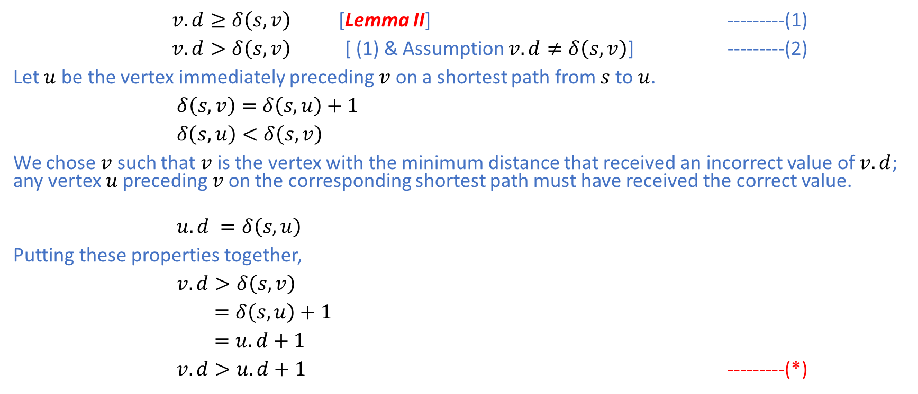
Breadth-First Search (BFS): Correctness
$v.d≥δ\left(s,v\right)$ [Lemma II] ---------(1)
$v.d>δ\left(s,v\right)$ [ (1) & Assumption $v.d≠δ\left(s,v\right)$] ---------(2)
Let $u$ be the vertex immediately preceding $v$ on a shortest path from $s$ to $u$.
$δ\left(s,v\right)=$ $δ\left(s,u\right)+1$
$δ\left(s,u\right)<δ\left(s,v\right)$
We chose $v$ such that $v$ is the vertex with the minimum distance that received an incorrect value of $v.d$; any vertex $u$preceding $v$on the corresponding shortest path must have received the correct value.
$u.d =δ\left(s,u\right)$
Putting these properties together,
$v.d>δ\left(s,v\right)$
$=δ\left(s,u\right)+1$
$=u.d+1$
$v.d>u.d+1$ ---------(*)

Slide 24
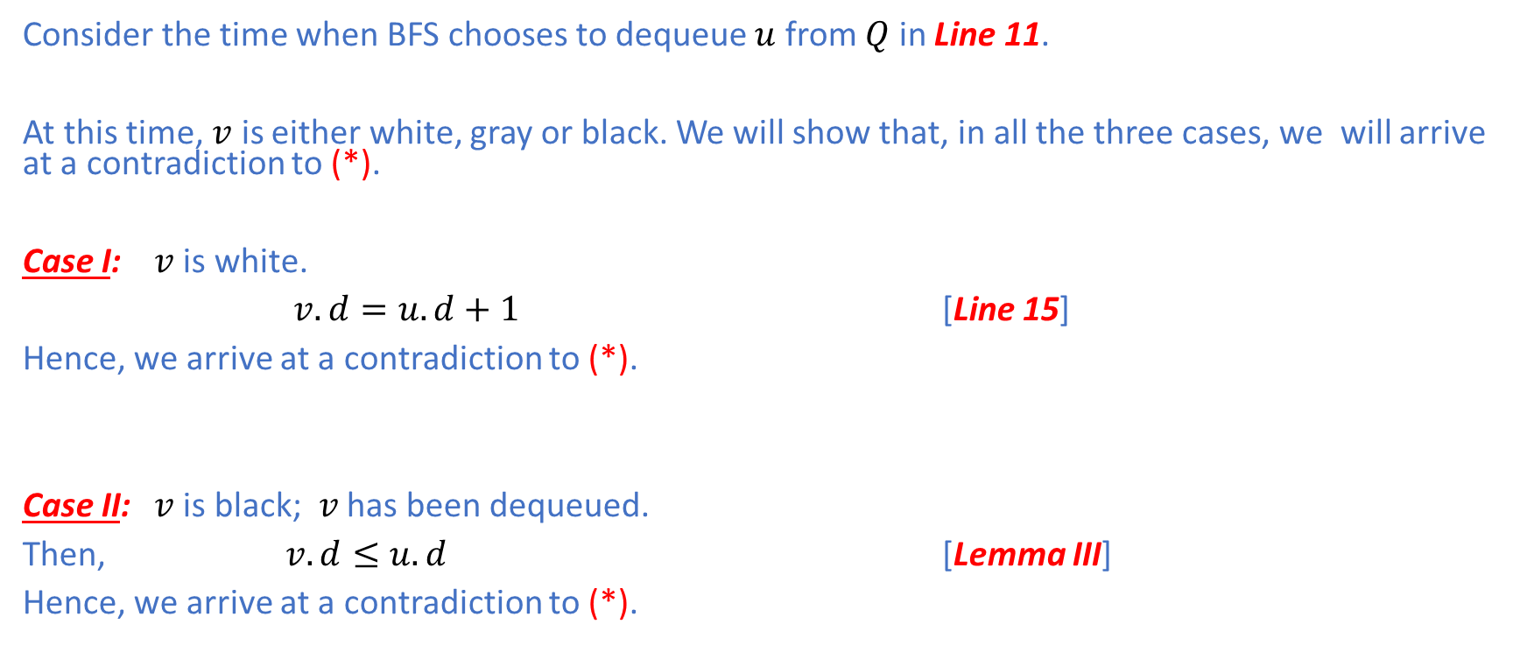
Breadth-First Search (BFS): Correctness
Consider the time when BFS chooses to dequeue $u$ from $Q$ in Line 11.
At this time, $v$ is either white, gray or black. We will show that, in all the three cases, we will arrive at a contradiction to (*).
Case I: $v$ is white.
$v.d=u.d+1$ [Line 15]
Hence, we arrive at a contradiction to (*).
Case II: $v$ is black; $v$ has been dequeued.
Then, $v.d≤u.d$ [Lemma III]
Hence, we arrive at a contradiction to (*).

Slide 25
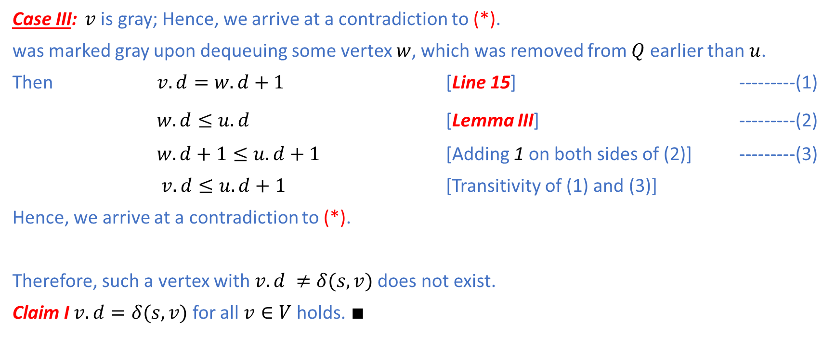
Breadth-First Search (BFS): Correctness
Case III: $v$ is gray; Hence, we arrive at a contradiction to (*).
was marked gray upon dequeuing some vertex $w$, which was removed from $Q$ earlier than $u$.
Then $v.d=w.d+1$ [Line 15] ---------(1)
$w.d≤u.d$ [Lemma III] ---------(2)
$w.d+1≤u.d+1$ [Adding 1 on both sides of (2)] ---------(3)
$v.d≤u.d+1$ [Transitivity of (1) and (3)]
Hence, we arrive at a contradiction to (*).
Therefore, such a vertex with$v.d ≠δ(s,v)$ does not exist.
Claim I $v.d=δ(s,v)$ for all $v∈V$ holds. $∎$

Slide 26
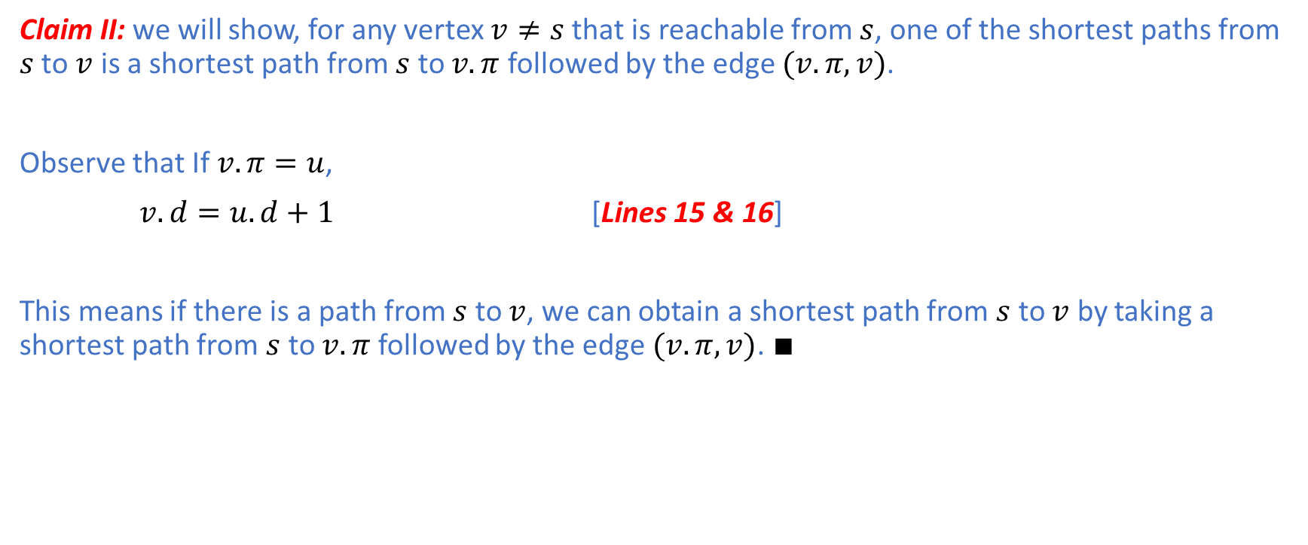
Breadth-First Search (BFS): Correctness
Claim II: we will show, for any vertex $v≠s$that is reachable from $s$, one of the shortest paths from $s$ to $v$ is a shortest path from $s$ to $v.π$ followed by the edge $(v.π,v)$.
Observe that If $v.π=u$,
$v.d=u.d+1$ [Lines 15 & 16]
This means if there is a path from $s$ to $v$, we can obtain a shortest path from $s$ to $v$ by taking a shortest path from $s$ to $v.π$ followed by the edge $(v.π,v)$. $∎$

Slide 27
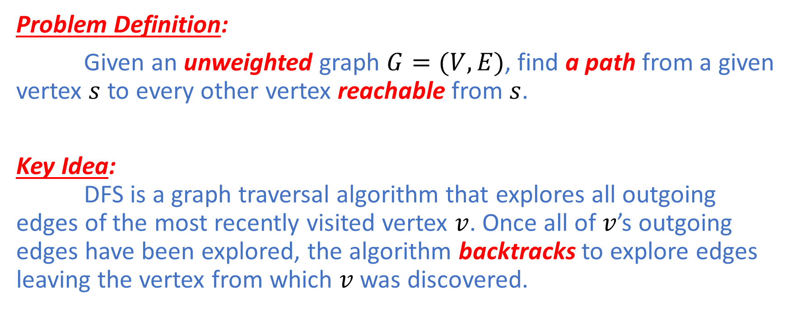
Depth-First Search (DFS)
Problem Definition:
Given an unweighted graph $G=(V,E)$, find a path from a given vertex $s$ to every other vertex reachable from $s$.
Key Idea: DFS is a graph traversal algorithm that explores all outgoing edges of the most recently visited vertex $v$. Once all of $v$’s outgoing edges have been explored, the algorithm backtracks to explore edges leaving the vertex from which $v$ was discovered.

Slide 28
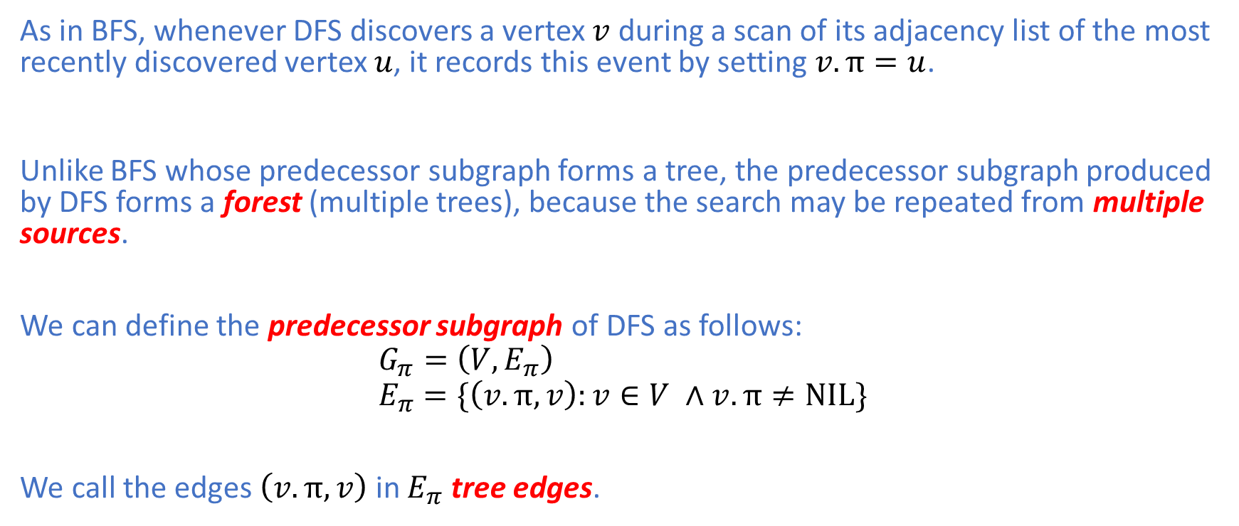
Depth-First Search (DFS) : Parent
As in BFS, whenever DFS discovers a vertex $v$ during a scan of its adjacency list of the most recently discovered vertex $u$, it records this event by setting $v.π=u$.
Unlike BFS whose predecessor subgraph forms a tree, the predecessor subgraph produced by DFS forms a forest (multiple trees), because the search may be repeated from multiple sources.
We can define the predecessor subgraph of DFS as follows:
$$G_{π}=\left(V,E_{π}\right) \\ E_{π}=\{\left(v.π,v\right):v∈V ∧v.π≠NIL\}$$
We call the edges $\left(v.π,v\right)$in $E_{π}$ tree edges.

Slide 29
Depth-First Search (DFS): Color
DFS relies on a similar vertex-coloring scheme to that of BFS as follows:
Initially, Each vertex is white.
It becomes gray when it is discovered during the search.
Eventually, it becomes black when it is finished, i.e., when its adjacency list is completely explored.
This coloring scheme can also ensures that each vertex ends up in exactly one DFS tree so that all the resulting DFS trees are disjoint.

Slide 30
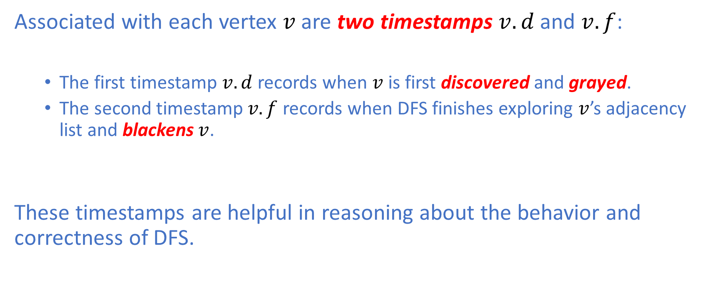
Depth-First Search (DFS) : Timestamp
Associated with each vertex $v$ are two timestamps $v.d$ and $v.f$:
The first timestamp $v.d$ records when $v$ is first discovered and grayed.
The second timestamp$v.f$ records when DFS finishes exploring $v$’s adjacency list and blackens $v$.
These timestamps are helpful in reasoning about the behavior and correctness of DFS.

Slide 31
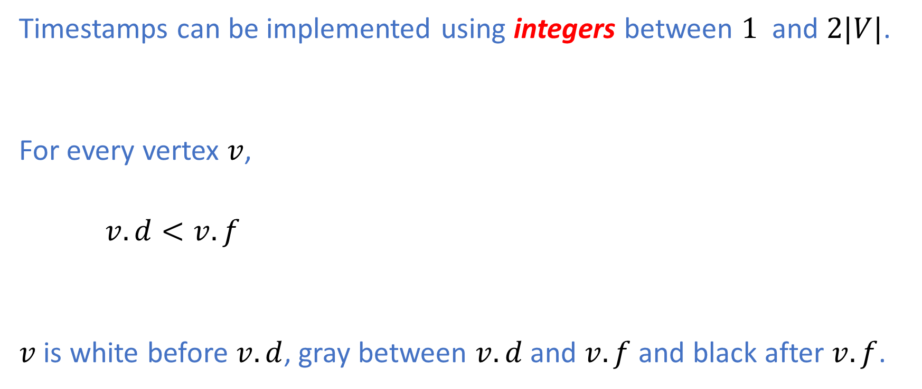
Depth-First Search (DFS) : Color and Timestamp
Timestamps can be implemented using integers between $1$ and $2|V|$.
For every vertex $v$,
$v.d<v.f$
$v$ is white before $v.d$, gray between $v.d$ and $v.f$ and black after $v.f$.

Slide 32
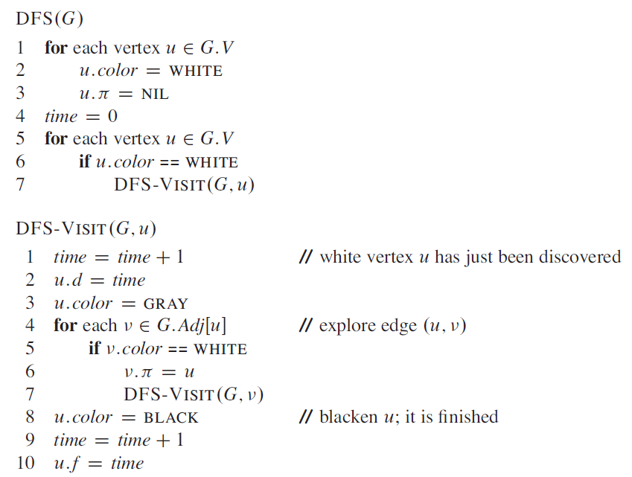
Depth-First Search (DFS) : Pseudocode

Slide 33
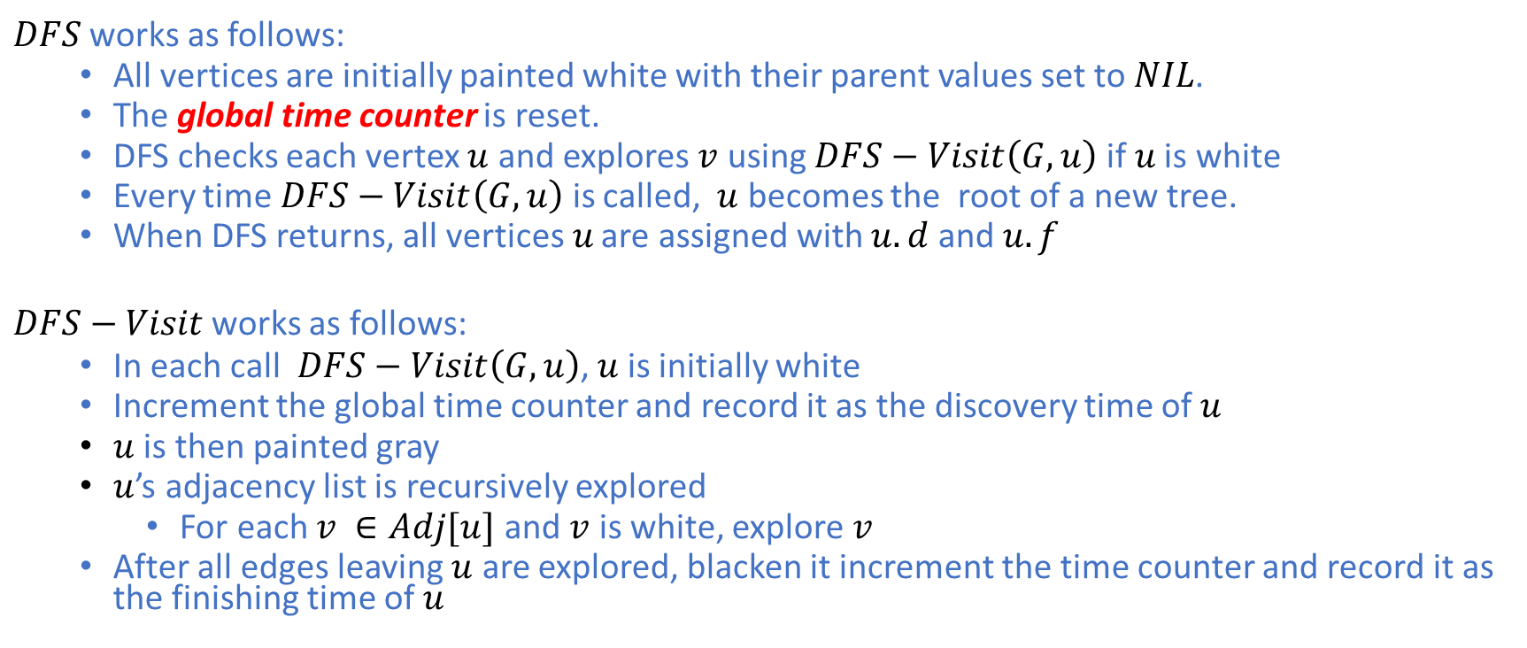
Depth-First Search (DFS) : Pseudocode
$DFS$ works as follows:
All vertices are initially painted white with their parent values set to $NIL$.
The global time counter is reset.
DFS checks each vertex $u$ and explores $v$ using $DFS−Visit\left(G,u\right)$ if$u$ is white
Every time $DFS−Visit\left(G,u\right)$ is called, $u$ becomes the root of a new tree.
When DFS returns, all vertices$u$ are assigned with $u.d$ and $u.f$
$DFS−Visit$ works as follows:
In each call $DFS−Visit\left(G,u\right)$, $u$is initially white
Increment the global time counter and record it as the discovery time of $u$
$u$ is then painted gray
$u$’s adjacency list is recursively explored
For each $v ∈Adj[u]$ and $v$ is white, explore $v$
After all edges leaving $u$ are explored, blacken it increment the time counter and record it as the finishing time of $u$

Slide 34
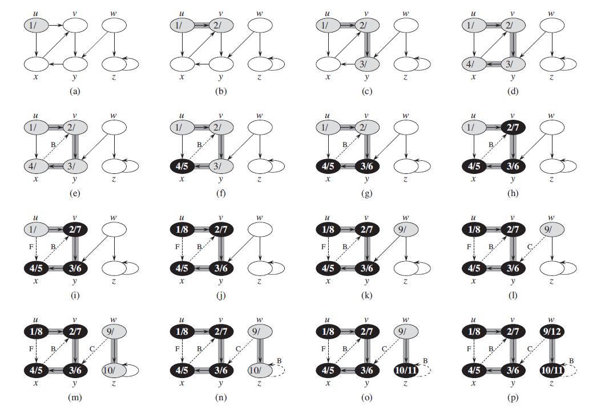
Depth-First Search (DFS) : Example

Slide 35
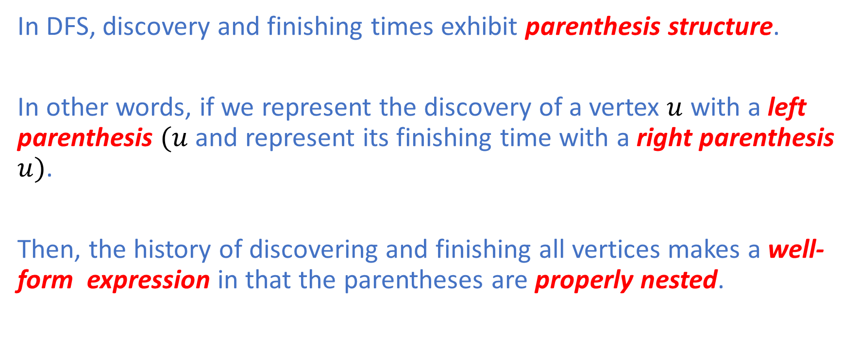
Depth-First Search (DFS) : Parenthesis Structure
In DFS, discovery and finishing times exhibit parenthesis structure.
In other words, if we represent the discovery of a vertex $u$ with a left parenthesis $(u$ and represent its finishing time with a right parenthesis $u)$.
Then, the history of discovering and finishing all vertices makes a well-form expression in that the parentheses are properly nested.

Slide 36
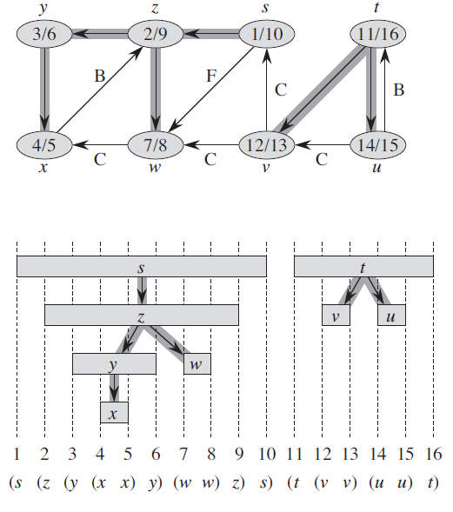
Depth-First Search (DFS) : Parenthesis Structure

Slide 37
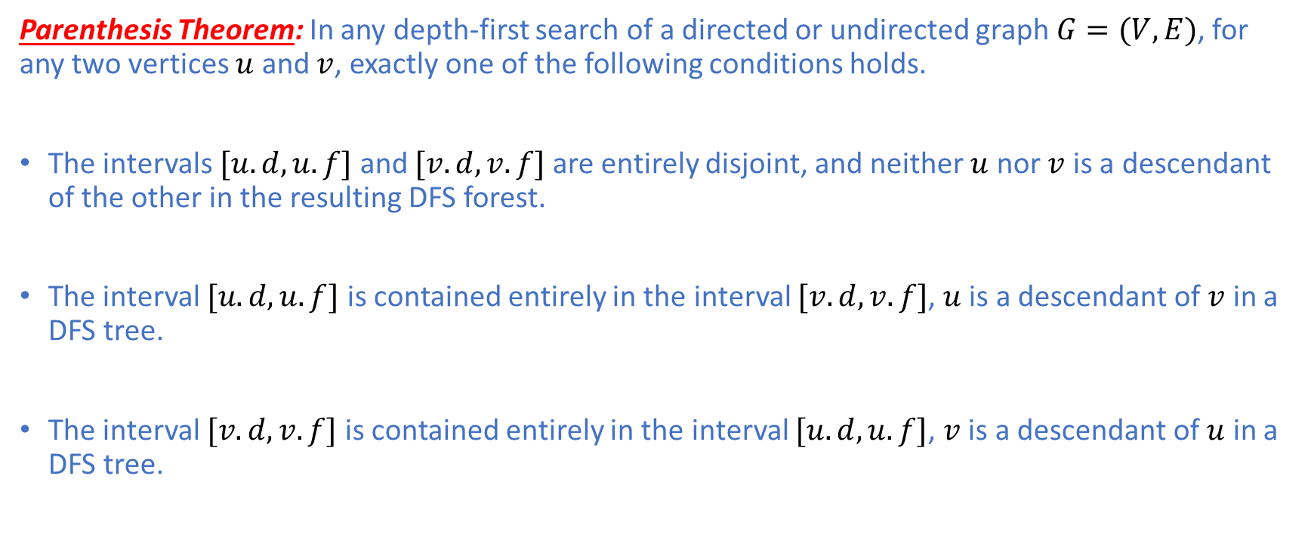
Depth-First Search (DFS) : Parenthesis Structure
Parenthesis Theorem: In any depth-first search of a directed or undirected graph $G=(V,E)$, for any two vertices $u$ and $v$, exactly one of the following conditions holds.
The intervals $[u.d,u.f]$ and $[v.d,v.f]$ are entirely disjoint, and neither $u$ nor $v$ is a descendant of the other in the resulting DFS forest.
The interval $[u.d,u.f]$ is contained entirely in the interval $[v.d,v.f]$, $u$ is a descendant of $v$ in a DFS tree.
The interval $[v.d,v.f]$ is contained entirely in the interval $[u.d,u.f]$, $v$ is a descendant of $u$ in a DFS tree.

Slide 38

Depth-First Search (DFS) : Parenthesis Structure
Lemma (Nesting of Descendants’ Intervals): Vertex $v$ is a proper descendant of vertex $u$ in the DFS forest for a directed or undirected graph $G=(V,E)$ if and only if $u.d<v.d<v.f<u.f$. Proof: The lemma follows Immediately from Parenthesis Theorem. $∎$

Slide 39
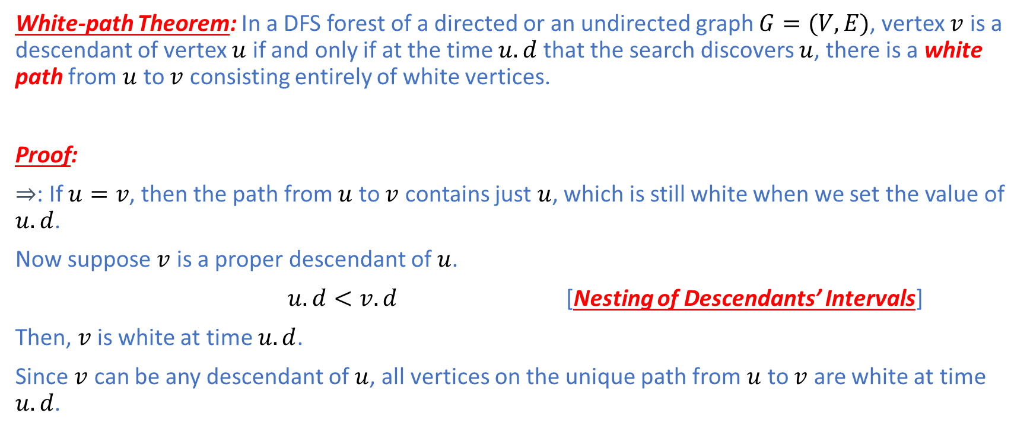
Depth-First Search (DFS) : Parenthesis Structure
White-path Theorem: In a DFS forest of a directed or an undirected graph $G=(V,E)$, vertex $v$ is a descendant of vertex $u$ if and only if at the time $u.d$ that the search discovers $u$, there is a white path from $u$ to $v$ consisting entirely of white vertices.
Proof:
$⇒$: If $u=v$, then the path from $u$ to $v$ contains just $u$, which is still white when we set the value of $u.d$.
Now suppose $v$ is a proper descendant of $u$.
$u.d<v.d$ [Nesting of Descendants’ Intervals]
Then, $v$ is white at time $u.d$.
Since $v$ can be any descendant of $u$, all vertices on the unique path from $u$ to $v$ are white at time $u.d$.

Slide 40
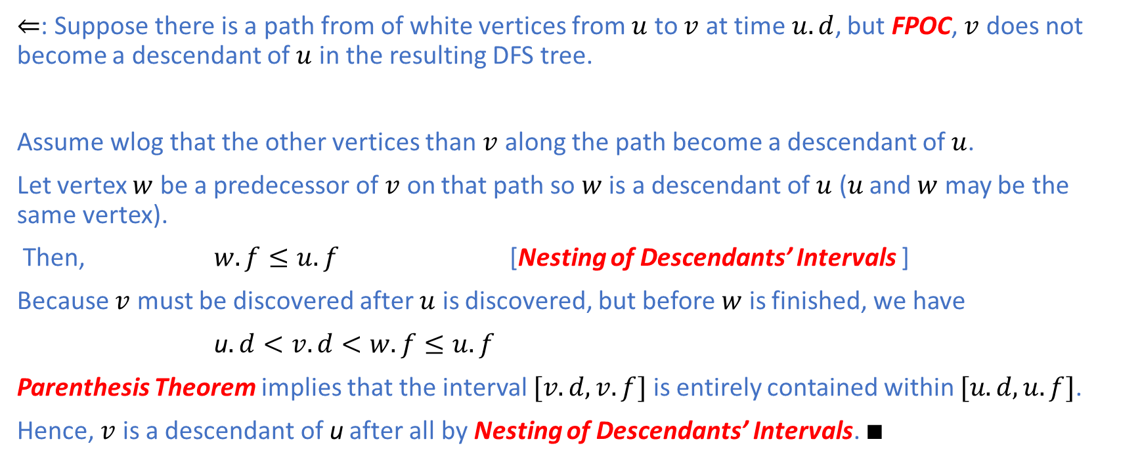
Depth-First Search (DFS) : Parenthesis Structure
$⇐$: Suppose there is a path from of white vertices from $u$ to $v$ at time$u.d$, but FPOC, $v$ does not become a descendant of $u$ in the resulting DFS tree.
Assume wlog that the other vertices than $v$ along the path become a descendant of$u$.
Let vertex $w$ be a predecessor of $v$ on that path so $w$ is a descendant of $u$ ($u$ and $w$ may be the same vertex).
Then, $w.f≤u.f$ [Nesting of Descendants’ Intervals ]
Because $v$ must be discovered after $u$ is discovered, but before $w$ is finished, we have
u$.d<v.d<w.f≤u.f$
Parenthesis Theorem implies that the interval $[v.d,v.f]$ is entirely contained within $[u.d,u.f]$.
Hence, $v$ is a descendant of u after all by Nesting of Descendants’ Intervals. $∎$

Slide 41
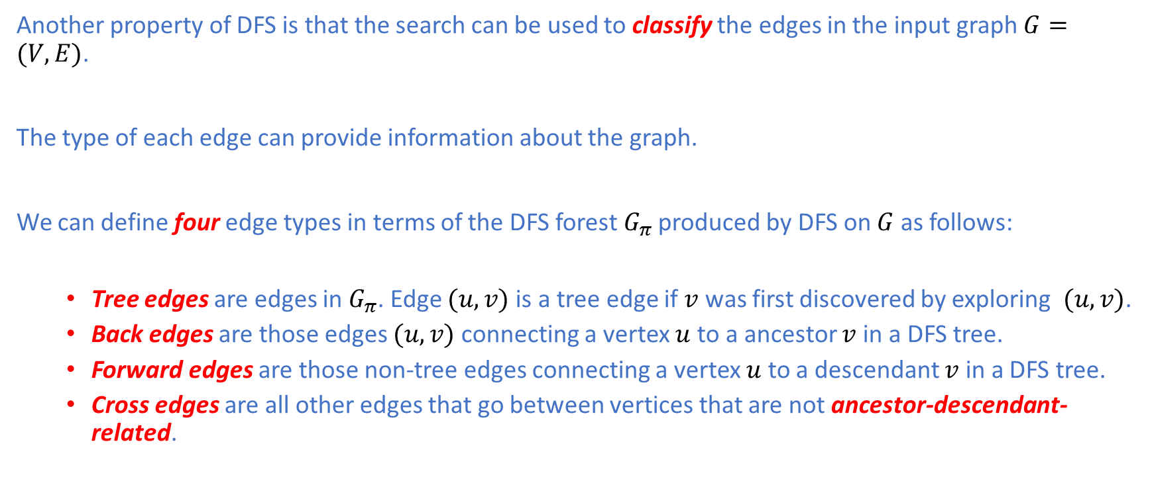
Depth-First Search (DFS) : Edge Classification
Another property of DFS is that the search can be used to classify the edges in the input graph $G=(V,E)$.
The type of each edge can provide information about the graph.
We can define four edge types in terms of the DFS forest $G_{π}$ produced by DFS on $G$ as follows:
Tree edges are edges in $G_{π}$. Edge $(u,v)$ is a tree edge if $v$ was first discovered by exploring $(u,v)$.
Back edges are those edges $(u,v)$ connecting a vertex $u$ to a ancestor $v$ in a DFS tree.
Forward edges are those non-tree edges connecting a vertex $u$ to a descendant $v$ in a DFS tree.
Cross edges are all other edges that go between vertices that are not ancestor-descendant- related.

Slide 42
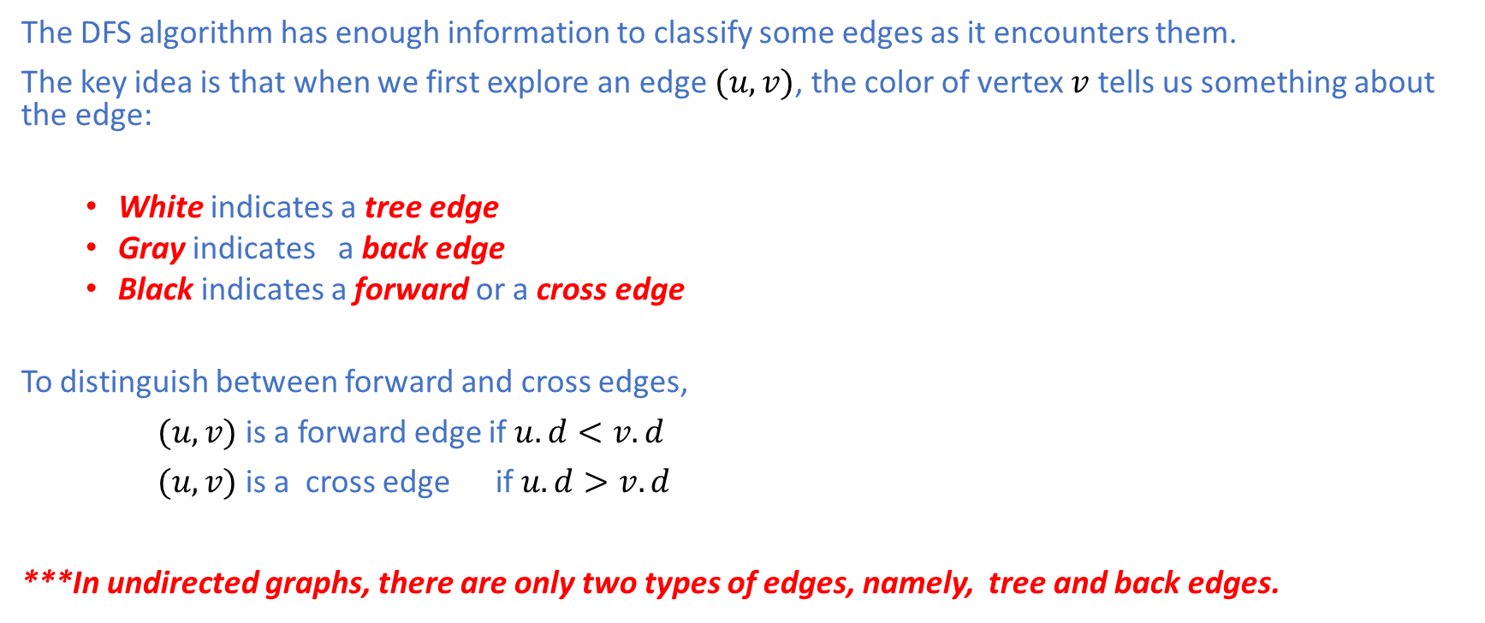
Depth-First Search (DFS) : Edge Classification
The DFS algorithm has enough information to classify some edges as it encounters them.
The key idea is that when we first explore an edge $(u,v)$, the color of vertex $v$ tells us something about the edge:
White indicates a tree edge
Gray indicates a back edge
Black indicates a forward or a cross edge
To distinguish between forward and cross edges,
$(u,v)$ is a forward edge if $u.d<v.d$
$(u,v)$ is a cross edge if $u.d>v.d$
***In undirected graphs, there are only two types of edges, namely, tree and back edges.

Slide 43
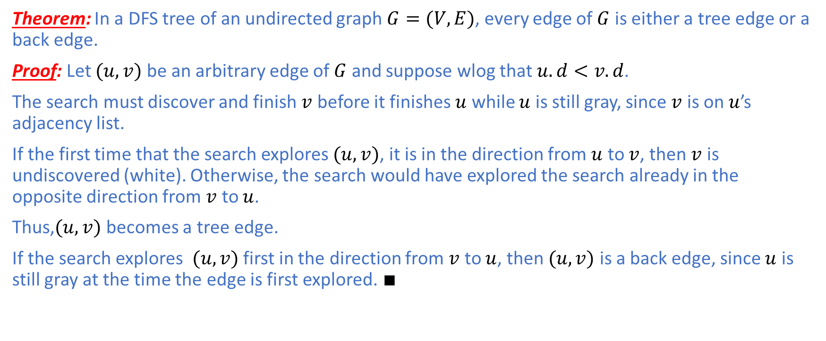
Depth-First Search (DFS) : Edge Classification
Theorem: In a DFS tree of an undirected graph $G=(V,E)$, every edge of $G$ is either a tree edge or a back edge.
Proof: Let $(u,v)$ be an arbitrary edge of $G$ and suppose wlog that $u.d<v.d$.
The search must discover and finish $v$ before it finishes $u$ while $u$ is still gray, since $v$ is on $u$’s adjacency list.
If the first time that the search explores $(u,v)$, it is in the direction from $u$ to $v$, then $v$ is undiscovered (white). Otherwise, the search would have explored the search already in the opposite direction from $v$ to $u$.
Thus,$(u,v)$ becomes a tree edge.
If the search explores $(u,v)$ first in the direction from $v$ to $u$, then $(u,v)$ is a back edge, since $u$ is still gray at the time the edge is first explored. $∎$

Slide 44
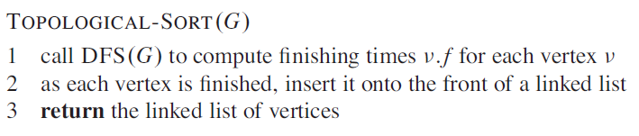
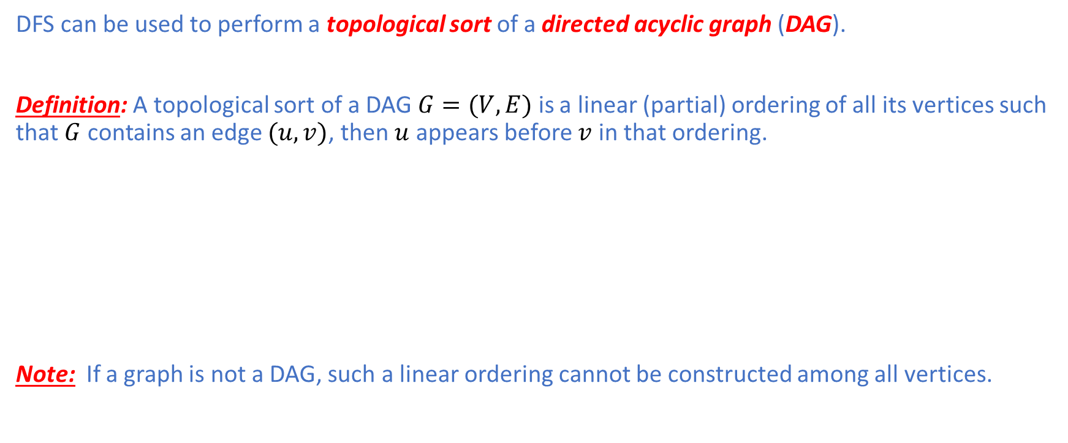
Topological Sorting
DFS can be used to perform a topological sort of a directed acyclic graph (DAG).
Definition: A topological sort of a DAG $G=(V,E)$ is a linear (partial) ordering of all its vertices such that $G$ contains an edge $(u,v)$, then $u$ appears before $v$ in that ordering.
Note: If a graph is not a DAG, such a linear ordering cannot be constructed among all vertices.

Slide 45
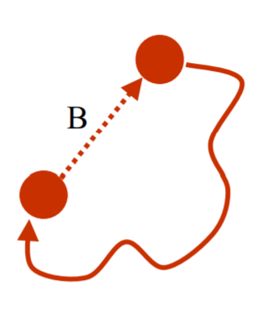
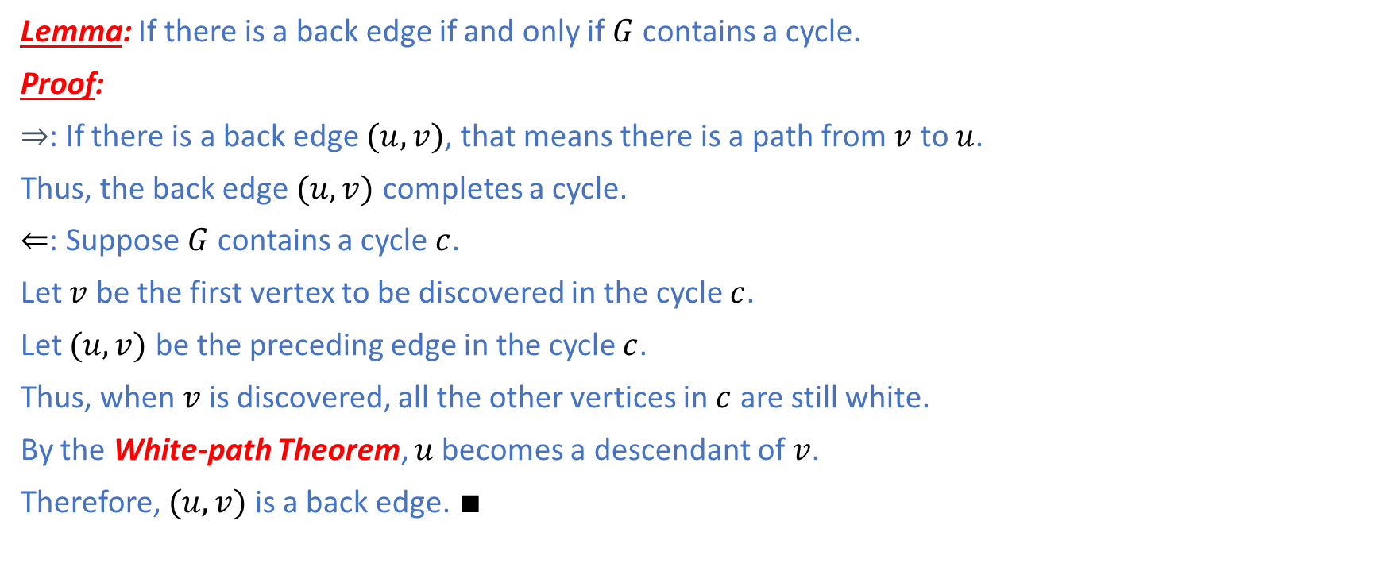
Directed Acyclic Graph
Lemma: If there is a back edge if and only if $G$ contains a cycle.
Proof:
$⇒$: If there is a back edge $(u,v)$, that means there is a path from $v$ to $u$.
Thus, the back edge $(u,v)$ completes a cycle.
$⇐$: Suppose $G$ contains a cycle $c$.
Let $v$ be the first vertex to be discovered in the cycle $c$.
Let $(u,v)$ be the preceding edge in the cycle $c$.
Thus, when$v$ is discovered, all the other vertices in $c$ are still white.
By the White-path Theorem, $u$becomes a descendant of $v$.
Therefore, $(u,v)$ is a back edge. $∎$

Slide 46
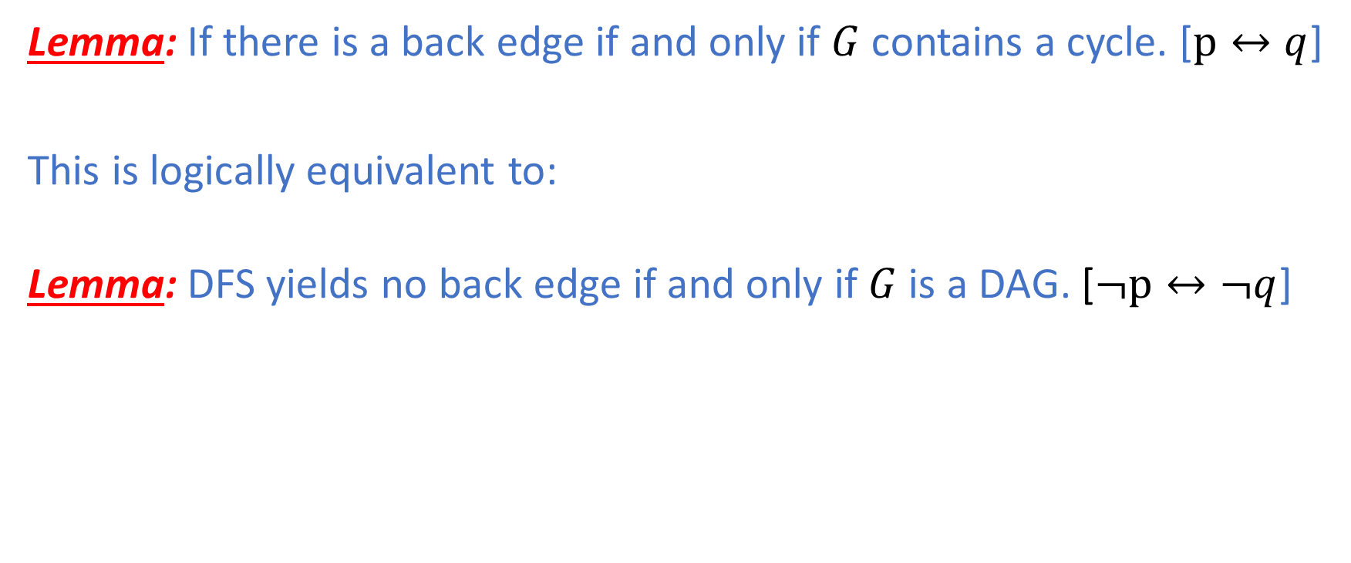
Directed Acyclic Graph
Lemma: If there is a back edge if and only if $G$ contains a cycle. [$p↔q$]
This is logically equivalent to:
Lemma: DFS yields no back edge if and only if $G$ is a DAG. [$¬p↔¬q$]

Slide 47
Summary
In this lecture, we have covered the topic of graph traversal techniques and their applications:
Breadth-First Search (BFS)
BFS Trees
Shortest Paths in Unweighted Graphs
Depth-First Search (DFS)
DFS Trees
Edge Classifications
Topological Sort
Directed Acyclic Graph
In the next lecture, we will cover Single-Source Shortest Path Problems.

